Slide 1


The Effects of Competition on Corporate Sustainability
Titing Cui, Esther Gal-Or, Mike M. Gordon,
Michael L. Hamilton and Jennifer Shang

Slide 2
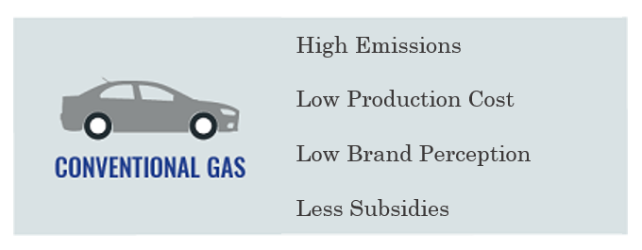
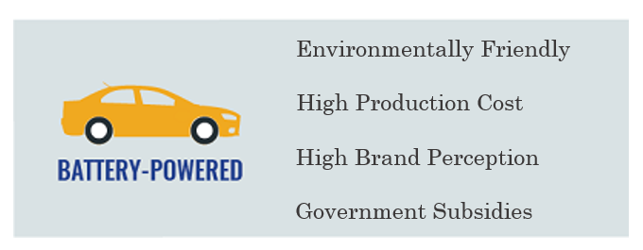

Green Production
Environmentally sustainably green products are often preferred by customers and orgs but are more costly to produce.
Example:
EVs operate at a substantially lower environmental impact per mile driven on carbon emissions but are more expensive to manufacture.
ICVs are not as eco-friendly as their electric cousins, economies of scale and decades of innovation have driven down their production costs

Slide 3
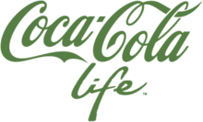
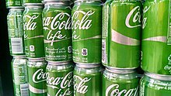
Corporate Social Responsibility
CSR is corporate investment in the community
A firm can improve its reputation among customers in a competitive market via CSR without necessarily greening its manufacturing processes.
A public display of social investment is often used to cover up a host of less visible non-green practices (greenwashing).

Slide 4
Research Question
What is the impact of green production cost for the interaction between competition and sustainability?
When policymakers subsidize producers of green products, which types of markets benefit most? Competitive or cooperative ones?
In which market (cooperative or competitive), do small changes in the additional cost of green technology lead to big changes in green market share?

Slide 5
Contributions
C1: Characterize competitive structure for two producers.
We characterize the optimal/equilibrium policies for the producers where they cooperate/compete in a natural location model.
We find lowering the green manufacturing costs increases the green market share and total CSR faster when the producers cooperate.
We find a green product is more readily introduced into the market when producers compete.
C2: Structured properties of the many producers in balanced market.
We generalize our model to the case of many producers, again find that when producers cooperate, there is significantly faster induced growth in green market share as opposed to when in competition .
C3: Further generalize the model to flexible producers.
If producers can decide to produce either a green or non-green product, we prove that the green market share and total CSR investment is always higher when producers cooperate than when they compete
Notes:
We consider a more realistic version of personalized pricing we term feature-based
pricing, and show how to transform our previous bounds into bounds on the value of
feature-based pricing over single price strategies (cf. Lemma 9 and Theorem 5) via a
novel extension theorem. These bounds makes explicit the relationship between the
accuracy of a sellers prediction model, and value of personalized pricing in a market.

Slide 6
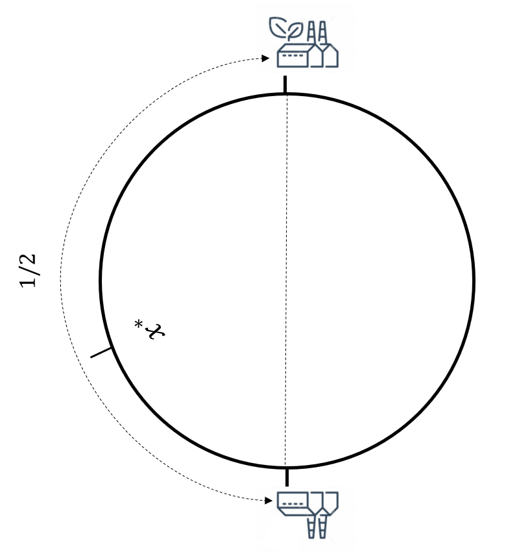
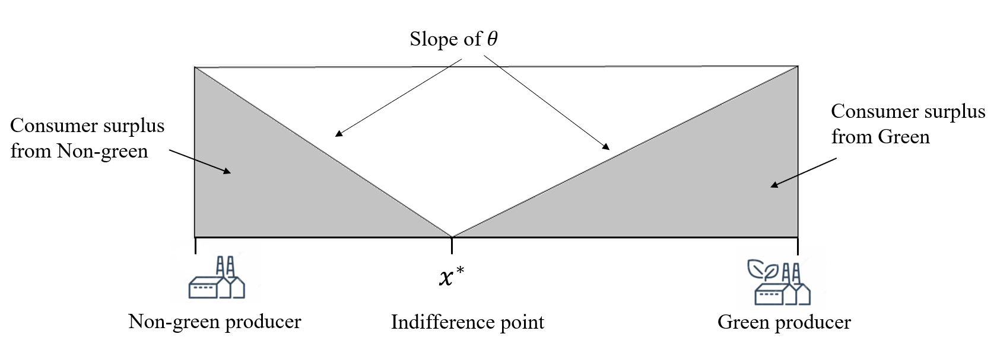
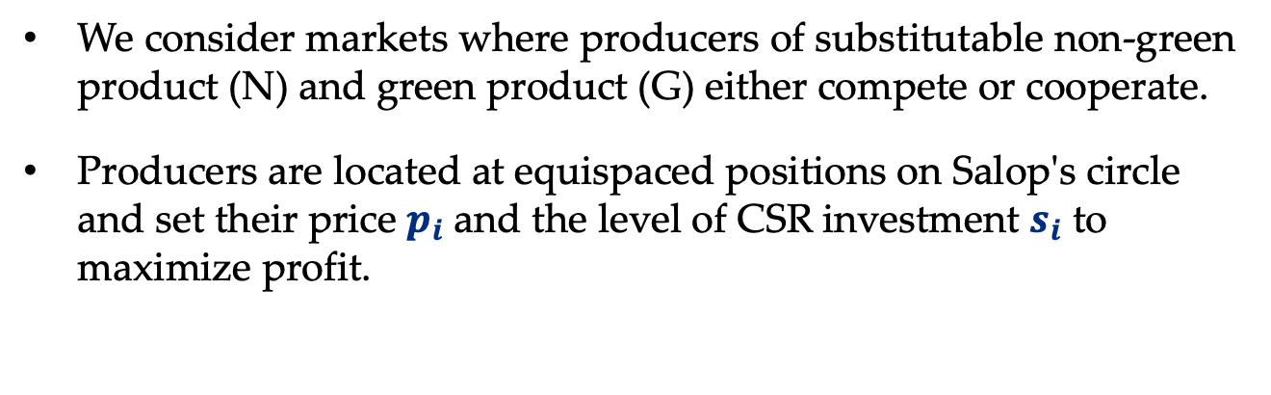
Model and Assumptions
We consider markets where producers of substitutable non-green product (N) and green product (G) either compete or cooperate.
Producers are located at equispaced positions on Salop's circle and set their price $p_{i}$ and the level of CSR investment $s_{i}$ to maximize profit.

Slide 7
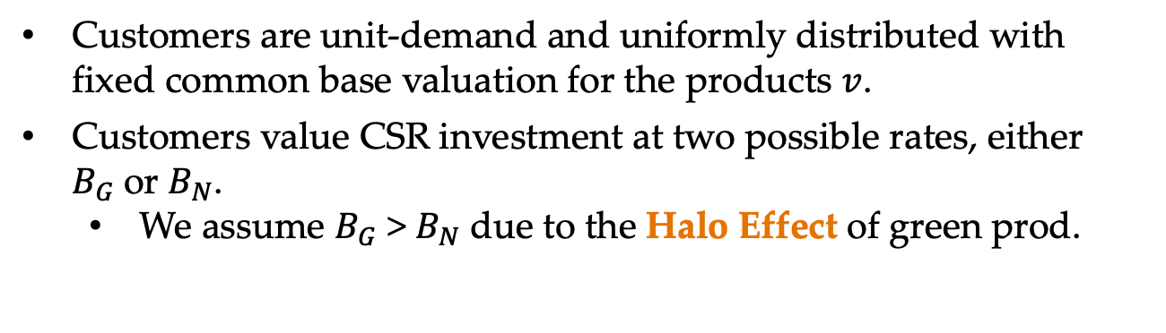
Model and Assumptions
Customers are unit-demand and uniformly distributed with fixed common base valuation for the products $v$.
Customers value CSR investment at two possible rates, either $B_{G}$or $B_{N}$.
We assume $B_{G}$ > $B_{N}$ due to the Halo Effect of green prod.

Slide 8
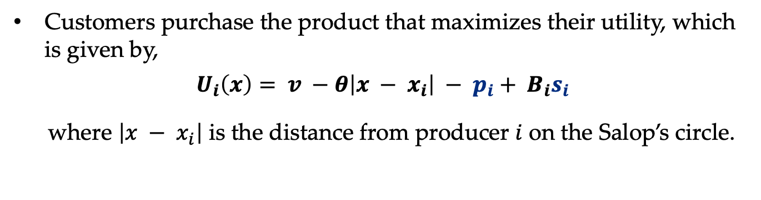
Model and Assumptions
Customers purchase the product that maximizes their utility, which is given by,
$$U_{i}\left(x\right)= v −θ\left|x − x_{i}\right| − p_{i}+ B_{i}s_{i}$$
where $\left|x − x_{i}\right|$ is the distance from producer $i$ on the Salop’s circle.

Slide 9
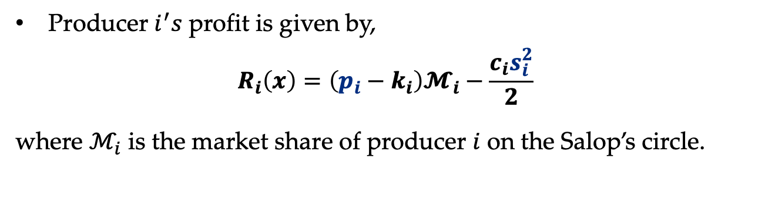
Model and Assumptions
Producer $i^{′}s$ profit is given by,
$$R_{i}\left(x\right)=\left(p_{i}−k_{i}\right)𝓜_{i}−\frac{c_{i}s_{i}^{2}}{2}$$
where $ℳ_{i}$ is the market share of producer $i$ on the Salop’s circle.

Slide 10

Monopoly and Duopoly
Theorem [Cooperation vs. Competition for Two Producers].
Suppose there are two profit-maximizing producers (Green and Non-green), located at opposing points on Salop's circle. If the parameters satisfy $B_{N}^{2}≤ c(θ−n)$and $B_{G}^{2}≤c\left(θ+ n\right)$, then:
The green market share and total CSR investment is decreasing in the green production cost $k$ in both markets.
The decrease is faster in the cooperative market compared to the competitive market.

Slide 11
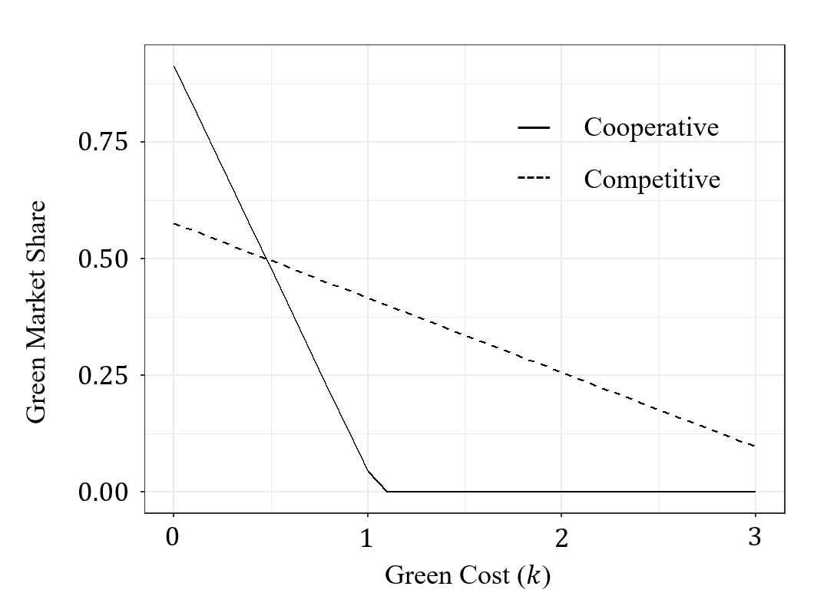
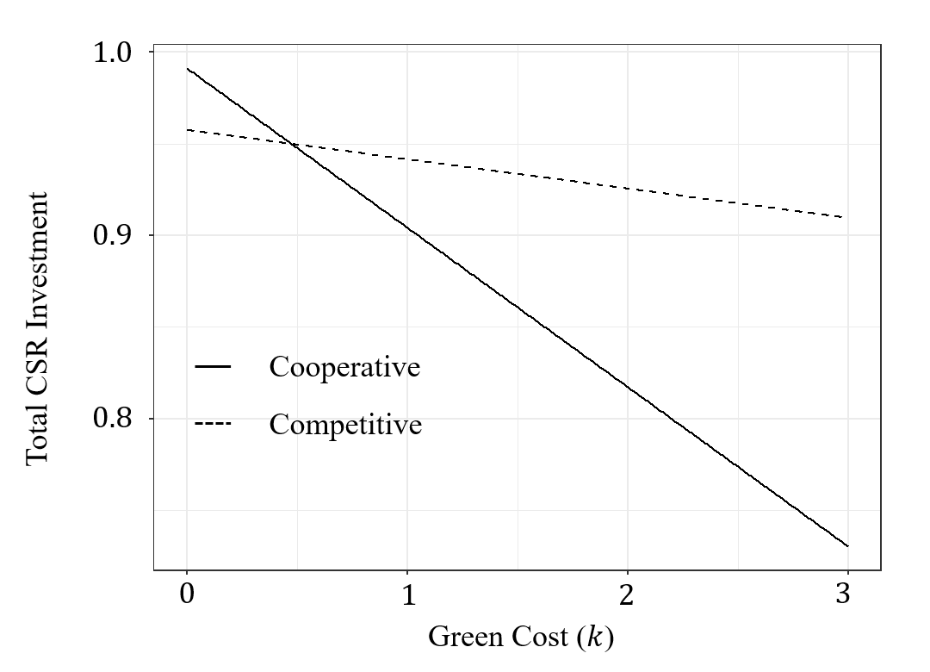
Monopoly and Duopoly
Takeaway
Decreasing green production costs will increase the green market share and total CSR investment faster in the cooperative market.

Slide 12
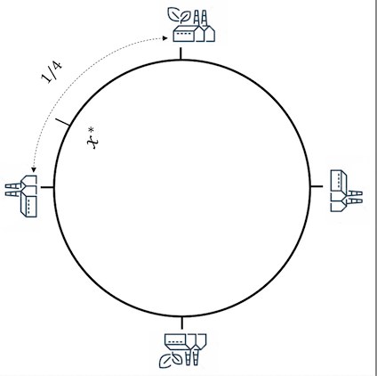
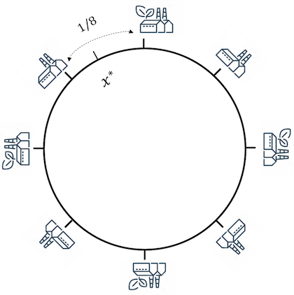
Beyond Two Producers
Increase the competition intensity by increasing the number of producers in the market.
Will assume producer types are balanced

Slide 13

Balanced Market
Theorem [Cooperation vs. Competition for 2n Producers].
Suppose there are 2n profit-maximizing producers (Green and Non-green), equispaced on Salop's circle. If the parameters satisfy $B_{N}^{2}≤ c(θ−kn)$and $B_{G}^{2}≤c\left(θ+ kn\right)$, then:
The green market share and total CSR investment is decreasing in the green production cost $k$ both in both markets.
The decreases is still faster in the cooperative market compared to the compared to the competitive market.
As n tends to infinity, in the cooperative balanced market, the green market share goes to either 0 or 1. In the competitive balanced the green market share always goes to 0.

Slide 14
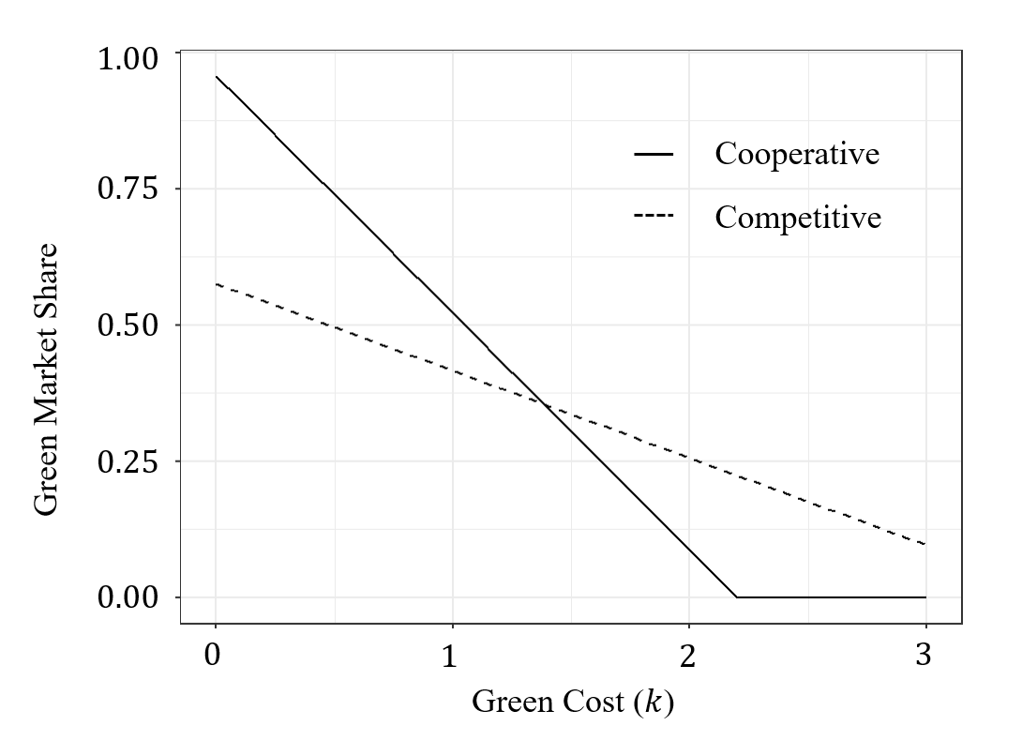
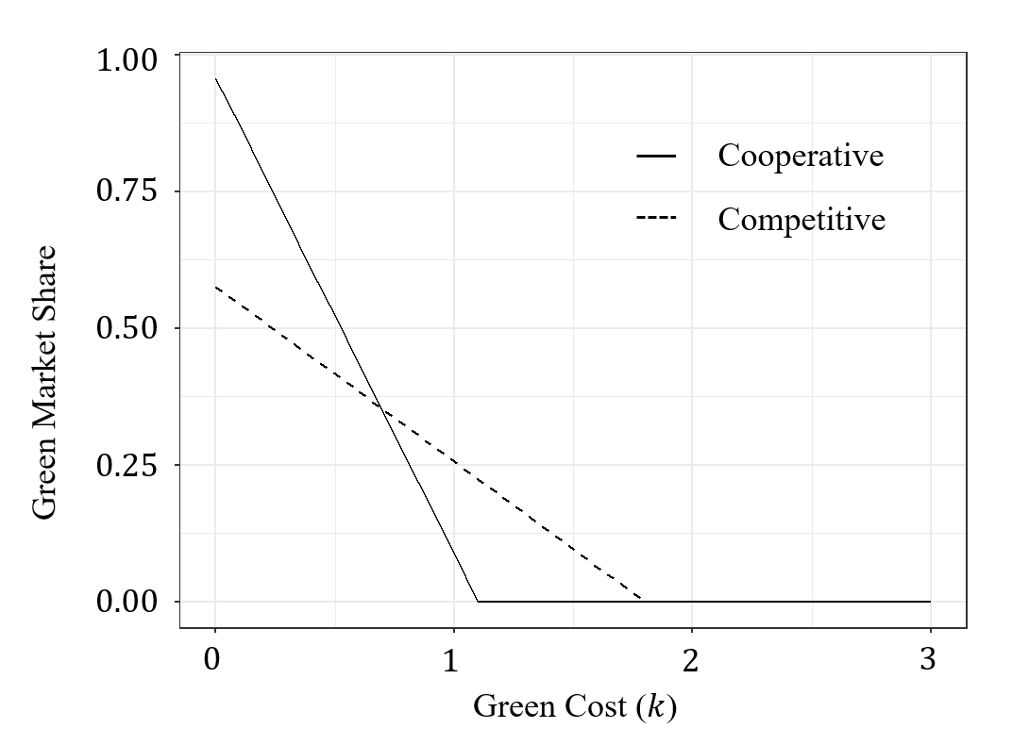
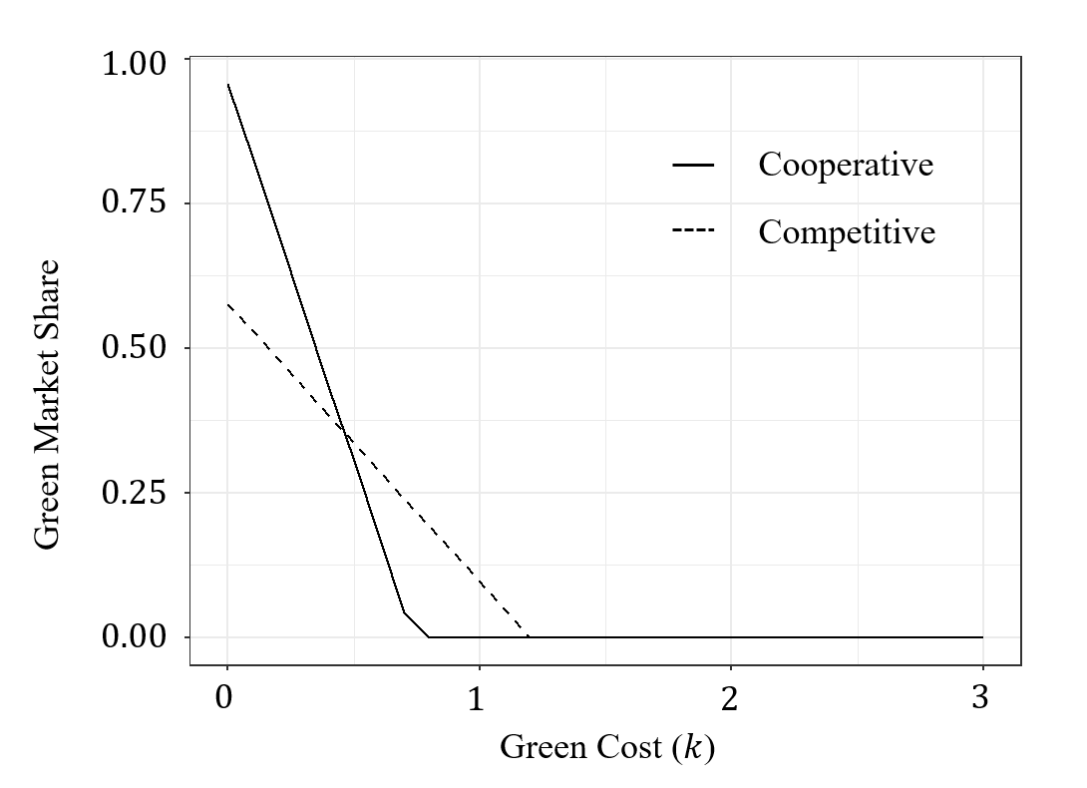
Balanced Market
Two Producers
Four Producers
Eight Producers
Takeaway
As competition intensifies, decreasing cost of green production will increase the green market share and total CSR investment in the cooperative market at sharper and sharper rates!
In both markets, more producers means it’s harder for the green product to be introduced into the market however

Slide 15
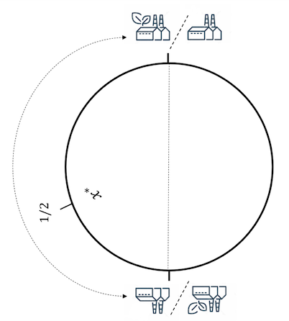
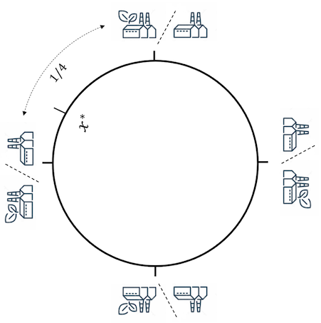
Flexible Production
Further allow firms to adaptive choose production type.

Slide 16

Flexible Producers
Theorem [Cooperation vs. Competition for Flexible Producers].
Suppose there are 2n profit-maximizing balanced, flexible producers located at evenly spaced points on Salop's circle. If the parameters satisfy $B_{N}^{2}≤ cθ$and $B_{G}^{2}≤ cθ$, then
The resulting market share for the green product is always higher when producers cooperate than when producers compete.
The total CSR investment product is always higher when producers cooperate than when producers compete.

Slide 17
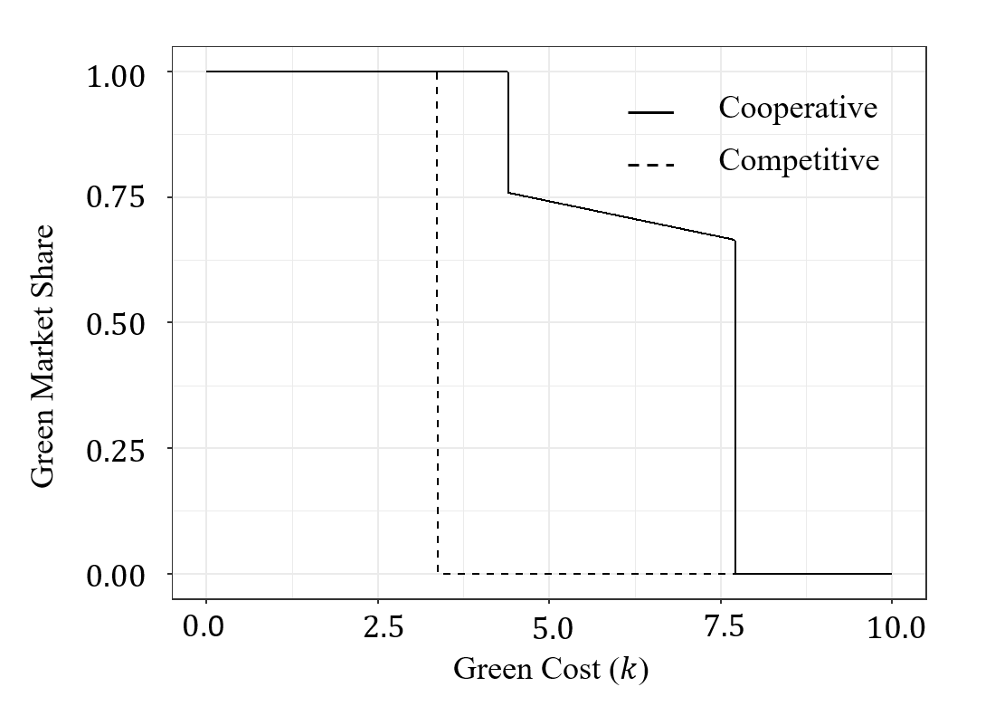
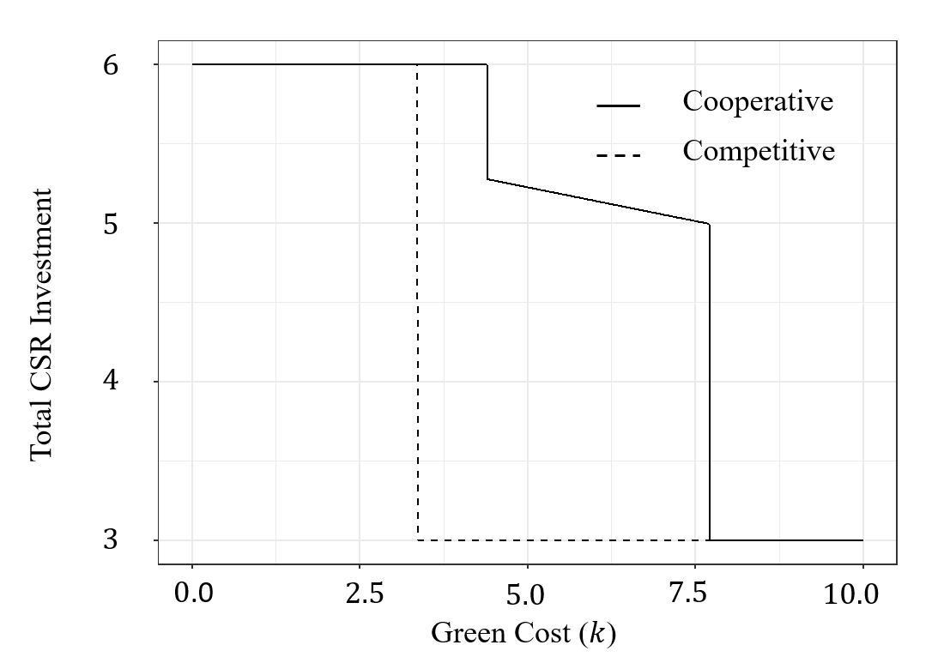
Flexible Producers
Tipping point (Competitive)
Tipping point (Cooperative)
Takeaway
When producers can choose their type, green technology is always more readily adopted in cooperative market.
We observe values of k where rapid adoption of the green product occurs.

Slide 18
Conclusions
We characterized optimal/equilibrium production strategy in the cooperative or competitive market.
We find increasing green production will decrease the green market share and total CSR investment, especially in the cooperative market.
When producers can choose their type, The tipping points in the cooperative market is large than the tipping point in the competitive market.
Green technology is more likely to be adopted in cooperative market of flexible producers.
Our findings provide important implications for policy-makers as they offer insights into which types of markets are most impacted by green production cost reduction.

Slide 19
Thank you!
Full paper: https://papers.ssrn.com/sol3/papers.cfm?abstract_id=4344348
Comments, questions @ mmgordon@vt.edu
More papers: https://mmgordon1.github.io/

